Slide 1
Revamped Course Registrar
Marco Haro-Crespa and Howard Yuan

Slide 2
Goals
Create modern web app to replace existing course registrar
Periodically scrape course catalog to update database
Overall ease of use when registering for courses

Slide 3
Stretch Goals
Implement queue based registration
Automatic registrations
4 year graduation planner
Per student login
Open class notification

Slide 4
Languages
Environment
Python 3
JS
HTML / CSS
Frameworks
Django
Selenium (Subject to Change)
Chrome Webdriver
Visual Studio Code
Windows 10

Slide 5
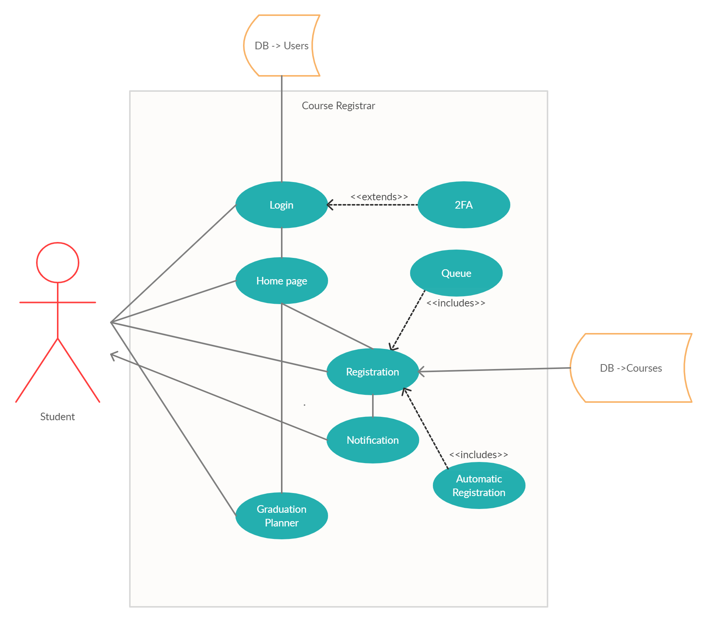
UML Diagram

Slide 6
Primary Use Cases
User interacts with login page
User taken to Home page
User can navigate to Registration or to Course Planner

Slide 7
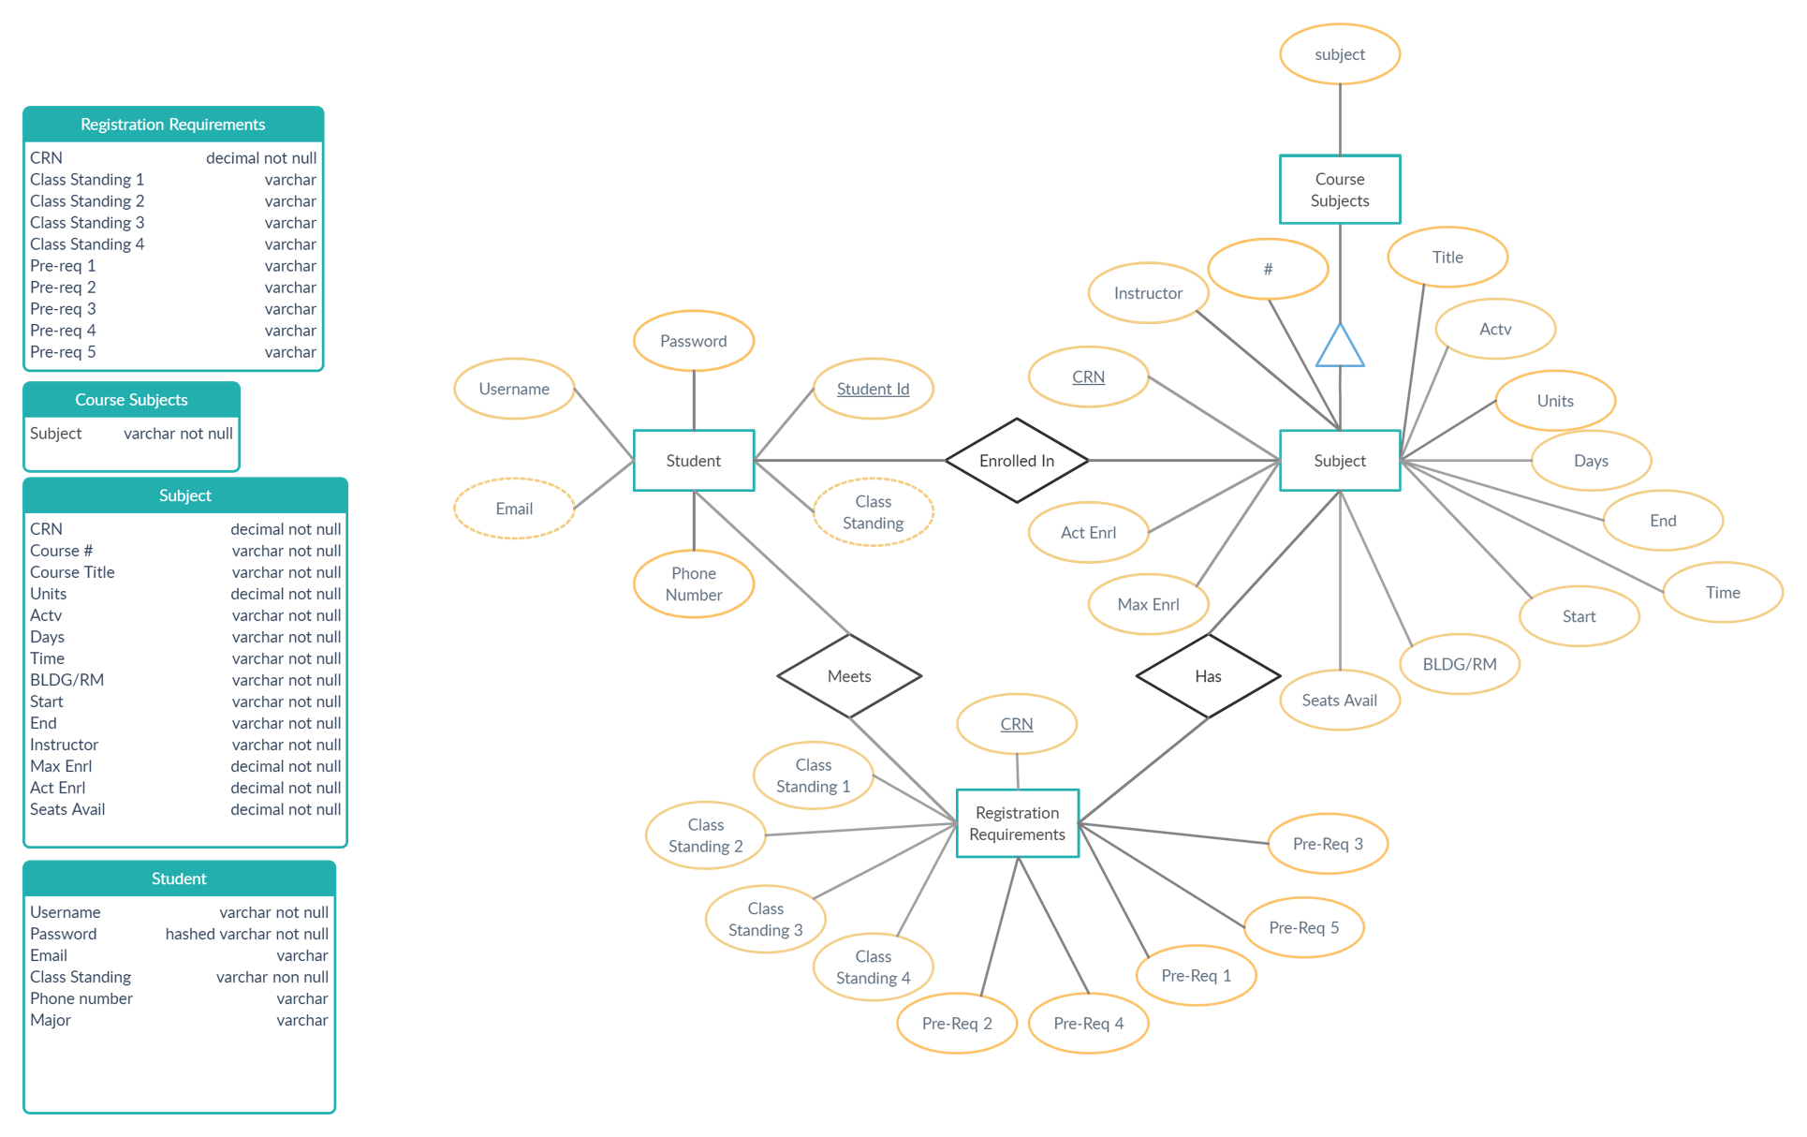
E/R Diagram & Schema

Slide 8
End

